Slide 1
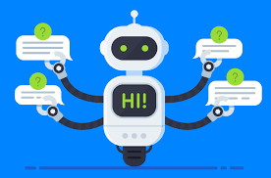
Dialogue Systems: Chatbots and Conversational AI
“Generally, a dialog system refers to a computer-based agent having a human-centric interface for accessing, processing, managing, and delivering information. Dialog systems are also known as chat information systems, spoken dialog systems, conversational agents, chatter robots, chatterbots, chatbots, chat agents, digital personal assistants, automated online assistants, and so forth.” - Vartul Mittal, “Go Beyond Chatbots with Conversational AI”
https://chatbotslife.com/go-beyond-chatbots-with-conversational-ai-85f4cb588bd5

Slide 2

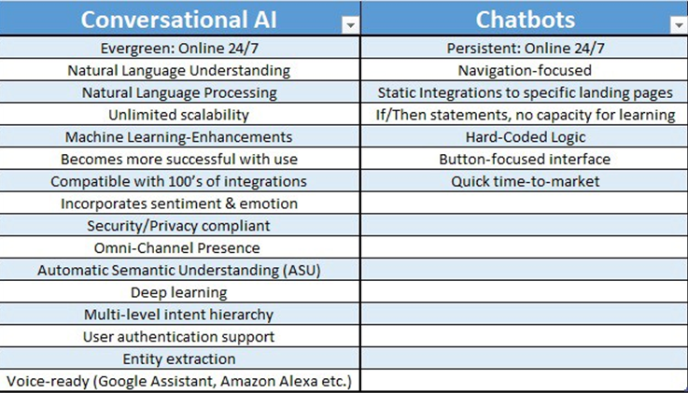
What are the Differences?
https://gofishdigital.com/context-based-natural-language-processing/

Slide 3

What are some of the ways digital assistants and conversational AI work?
Example 1
Example 2
First, they translate your words into text. This is typically done using the Hidden Markov Models system (HMM). This translates the speech into text that can be processed by the NLP system
The HMM identifies phonemes and compares with pre-recorded speech. Then the systems break down each word into its part of speech.
The algorithm used uses coded grammar rules to determine the context of the speech.
Entities and intent are extracted; an NLP model is built for every entity and intent. For example, there may be a model that recognizes when a user is asking for directions, or checking the opening hours of a business based on the user’s location.
The assistant responds with either an answer or by performing a requested action.
” While words are finite, their meaning is not (slang, accents, etc.). Machine Learning and NLP makes it so these don’t all have to be programmed. “They rather learn about our language patterns through experience and usage patterns… For instance ‘she is a professor’ in French is read as ‘elle est professeur’, So machine learning algorithms predict that ‘she is a dancer’ will also begin with ‘elle est.’ Now, the computer needs to figure out the word for ‘dancer’ in French that is ‘danseuse’” – Springboard India, “Natural Language Processing Use Case: How do Personal Assistant Apps Work
https://in.springboard.com/blog/natural-language-processing/

Slide 4

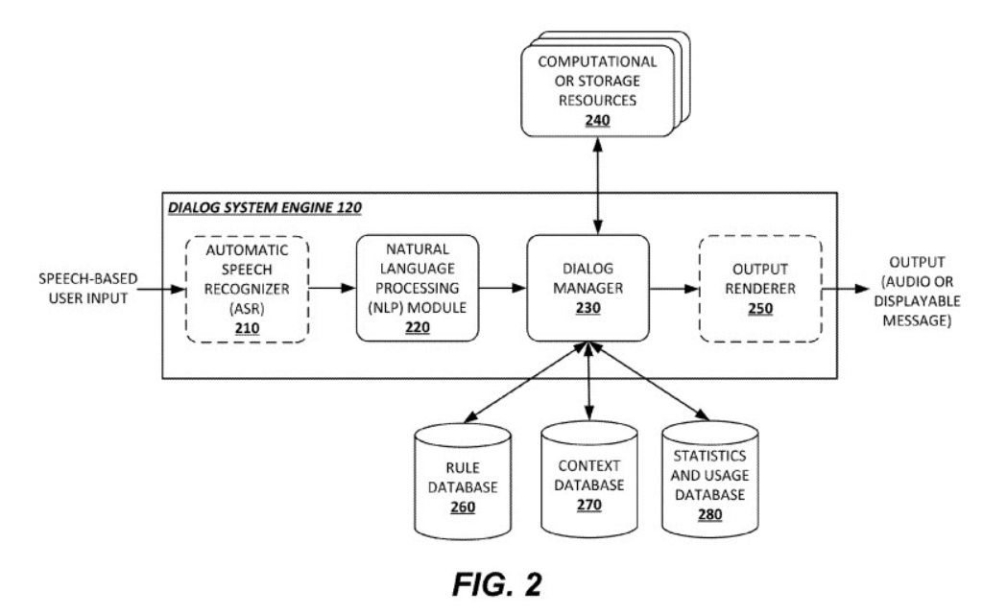
Back
https://gofishdigital.com/context-based-natural-language-processing/

Slide 5

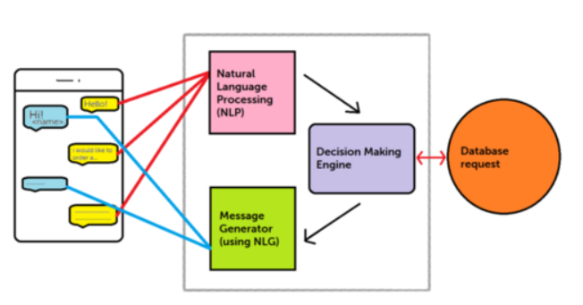
Back
https://discover.bot/bot-talk/behind-the-scenes-using-nlp-to-power-chatbot/

Slide 6

First, Alexa attempts to identify and minimize ambient noise so only the important signal remains.
Wake Word Detection: detects the word needed to turn the device on.
Sends copy of the input speech to Amazon cloud for analysis.
Breaks statement into various sounds.
Uses a database containing various words’ pronunciation to determine which words correspond to the individual sounds.
Identifies important words and carries out the corresponding actions.
https://in.springboard.com/blog/natural-language-processing/

Slide 7

Is first activated by voice or text
Then gathers information from Bing, which has access to
  Tellme’s Natural Language Processing
  Satori knowledge repository
  Microsoft’s cloud processing power
  Then learns about user and their patterns and stores the highlights in Notebook
Assessment and analysis take place through Cortana’s intelligence
A suitable action or answer is delivered.
  Cortana was one of the first to be neural network based (Apple was inspired by Cortanta to begin using neural networks for Siri)
  The Cortana Skills Kit gives individuals a suite of tools to help individuals/businesses build their own Cortana based conversational AI to develop skills for Cortana. Example
https://www.windowscentral.com/neural-networks-and-natural-language-processing-what-are-they-and-microsoft
https://in.springboard.com/blog/natural-language-processing
https://docs.microsoft.com/en-us/cortana/skills/overview

Slide 8
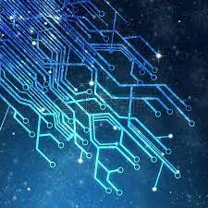
User: "Ask Contoso Photo what the status of my photo order is."
Cortana: "Your photo order will be ready in an hour."
Cortana: "Can I help you with anything else?"
User: "What did I order?"
Cortana: "Three copies of prints on glossy paper. Would you like to make a change?"
User: "Make it matte paper."
Cortana: "You would like to change the paper to matte. Is this correct?"
User: "Yes."
Cortana: "Your order has been updated.“
Intent can be determined by inspecting content using regular expressions, or Language Understanding Intelligent Service (LUIS).
  LUIS uses either pre-built or custom trained models to to determine intent and identify entities and concepts.
https://www.itprotoday.com/artificial-intelligence/microsoft-aims-raise-cortanas-business-cred-through-use-natural-language

Slide 9


Uses speech recognition and NLP.
Records frequencies and converts them into a speaker vector that can determine phonetic content, user, and background environment, then converts them into a code.
Breaks down code to identify patterns and keywords. These are input into an algorithm where the cosine score is computed against other speak vectors and matched against combinations of sentences to identify meaning.
Uses Deep Neural Networks and algorithms that determine the context of sentences through working around various literary expressions. See Chart.
Assess the tasks to be performed.
Determines if the information is available in the phone’s data bank or if it needs to be retrieved from the internet.
Lastly, it answers the question originally proposed.
https://in.springboard.com/blog/natural-language-processing/

Slide 10

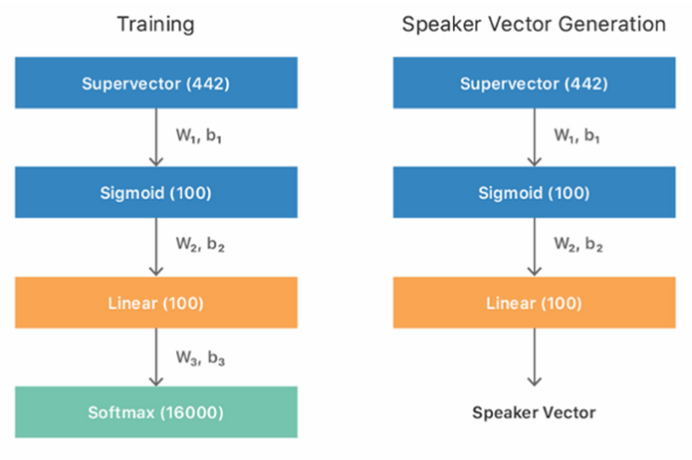
“Based on recent experiments, a network structure of four 256-neuron layers with sigmoid activations, followed by a 100-neuron linear layer has proven to achieve the best results.” - Komal Saini, "Natural Language Processing ft. Siri"
https://medium.com/mytake/natural-language-processing-ft-siri-2bc7b854a2a3

Slide 11


https://www.techrepublic.com/article/google-assistant-the-smart-persons-guide/
Utilizes
  Entity Extraction: Entities are extracted and assigned actions using machine learning algorithms.
  Intent Recognition: A Machine Learning Model recognizes the intent of the speech, generates dialogue and determines appropriate action..
  Dialogue Generation: Each app has its own dialogue mode that generates the determined response.
  Also uses NLP and machine learning to understand speech and make suggestions or take actions based on that speech.
Provides contextual information and performs appropriate actions
Wake Words: While the words “okay, Google” were required prior to each individual inquiry, the 2018 feature Continued Conversation enabled back-and-forth conversations.
Routines Feature: This feature allows the user to program a string of multiple actions with a single voice command. One example of this would be to say "Hey Google, I am home," which could trigger lights to come on.
Can use the device camera to identify objects and gather visual information through the device's camera.
A software development kit was released, allowing third-party developers to build their own hardware that can run the Google Assistant.
Duplex was created to speak in a more natural voice and language by incorporating filler words such as like "hmm" and "uh" and using slang phrases like "mhm" and "gotcha“.
https://in.springboard.com/blog/natural-language-processing

Slide 12

Overcoming Challenges and What Comes Next?
According to a recent study, “current technologies may be reaching their peak capabilities. The next big uptick will likely require a new generation of algorithms. This is something all the major players are surely working on.” – Kaila Krayewski, “The Current State of NLP, Voice Search, and Voice Assistants”
If conversational bots learn from humans, they will learn biases as well. To attempt to combat this, data is first vetted by humans to reduce bias and incorrect information.
“One way, Natural Language Processing is overcoming the hurdles is by starting small. For example, smart speakers and virtual assistants provide limited options in terms of domains they can interact in. There are fewer domains in which they can assist a user for now. A new domain is added every other day but we can notice that it is a step by step process. These systems are taking one domain at a time, perfecting it, building upon the knowledge and expertise gained, before testing new waters.” – Asad Butt, “Artificial Intelligence, Natural Language Processing, Machine Learning, AND Voice Search: A Match Made in Heaven”
“One of the most significant challenges when it comes to chatbots is the fact that users have a blank palette regarding what they can say to the chatbot. While you can try to predict what users will and will not say, there are bound to be conversations that you would never imagine in your wildest dreams.” - Casey Phillips, “Natural Language Processing & Why Chatbots Need It.” Let me tell you about the time I worked in HR and got a call about wild pigs… or the lady who was upset when I told her I could email her the document she needed right away… Or the guy who was furious he won $50… Or this other time…
Privacy concerns are one of the biggest obstacles. In order to improve learning, inquiries are recorded and reviewed. When what is needed to improve a technology is inherently a privacy grey area, there will always be debates on how these recordings and the information they provide are handled, reviewed and stored. This is especially called into question when devices start recording even when wake words are not used. (Example: Siri has been known to begin recording at the word “seriously.”
https://quoracreative.com/article/voice-search-evolution
https://gofishdigital.com/context-based-natural-language-processing/
https://chatbotslife.com/go-beyond-chatbots-with-conversational-ai-85f4cb588bd5
https://www.ultimate.ai/blog/ai-automation/the-current-state-of-nlp-voice-search-voice-assistants

Slide 13
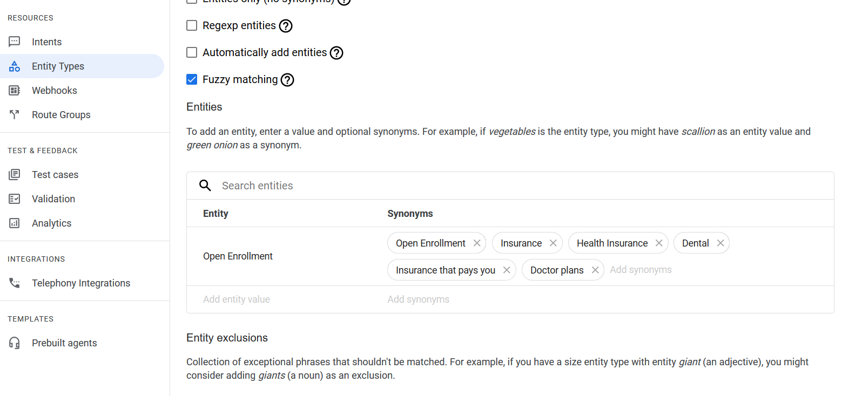
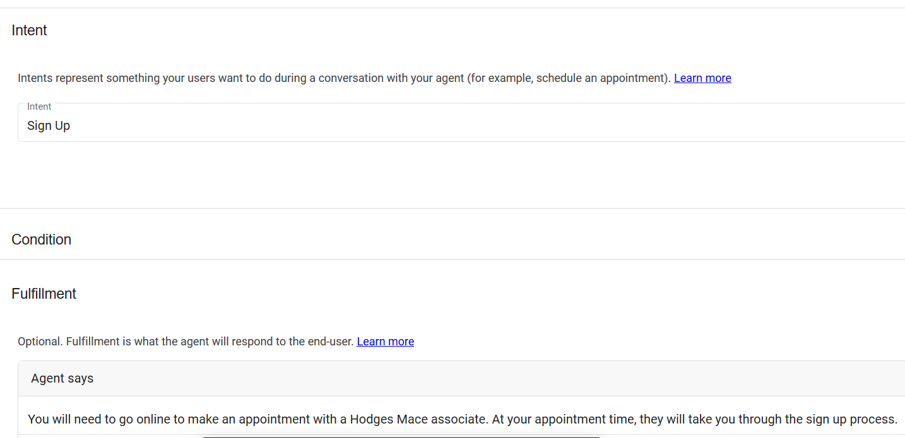


Demo: https://cloud.google.com/dialogflow/cx/docs/concept/entity#custom
Google Dialog Flow has a variety of option for creating an AI conversational chat bot. There are various levels of pre-made templates individuals and businesses can utilize and build upon, or they can make one custom designed.
Creators enter any numbers of entities and intense, the phrases that should trigger these entities/intents, and how the bot should respond to any combination of.
I was able to create a bot that would succinctly respond to employees calling about Open Enrollment, a hellish time for HR staff that could be improved with conversational AI. I entered some of the typical phrases employees would use, as well as some of the noteable weird and outlandish phrases employees have used in the past.
…Benefits would be the sanity of the entire HR department
Survived open enrollment

Slide 14
References
https://in.springboard.com/blog/natural-language-processing/
https://www.techrepublic.com/article/google-assistant-the-smart-persons-guide/
https://www.ultimate.ai/blog/ai-automation/the-current-state-of-nlp-voice-search-voice-assistants
https://docs.microsoft.com/en-us/cortana/skills/overview
https://www.itprotoday.com/artificial-intelligence/microsoft-aims-raise-cortanas-business-cred-through-use-natural-language
https://medium.com/mytake/natural-language-processing-ft-siri-2bc7b854a2a3
https://gofishdigital.com/context-based-natural-language-processing/
https://chatbotslife.com/go-beyond-chatbots-with-conversational-ai-85f4cb588bd5
https://www.windowscentral.com/neural-networks-and-natural-language-processing-what-are-they-and-microsoft
https://quoracreative.com/article/voice-search-evolution
https://discover.bot/bot-talk/behind-the-scenes-using-nlp-to-power-chatbot/
https://chatbotsmagazine.com/natural-language-processing-nlp-why-chatbots-need-it-a9d98f30ab13

